Slide 1
PCA(Principle Component Analysis)

Slide 2
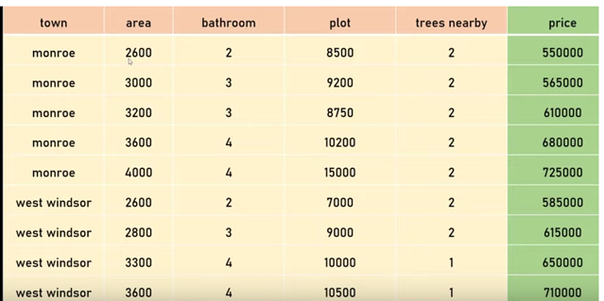

Slide 3
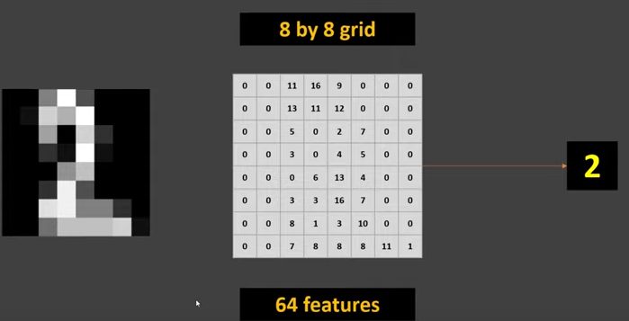

Slide 4
Curse of Dimensionality
Curse of Dimensionality refers to a set of problems that arise when working with high-dimensional data. The dimension of a dataset corresponds to the number of attributes/features that exist in a dataset. A dataset with a large number of attributes, generally of the order of a hundred or more, is referred to as high dimensional data. Some of the difficulties that come with high dimensional data manifest during analyzing or visualizing the data to identify patterns, and some manifest while training machine learning models. The difficulties related to training machine learning models due to high dimensional data is referred to as ‘Curse of Dimensionality’.

Slide 5
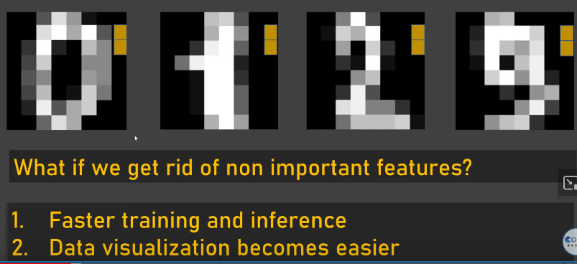

Slide 6
PCA
PCA is a process of figuring out most important features or principal components that has the most impact on the target variable.
In other word, PCA is called dimensionality reduction technique as it helps to reduce dimensions.

Slide 7
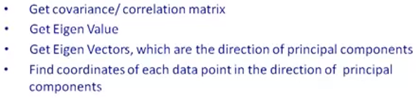
PCA Steps

Slide 8
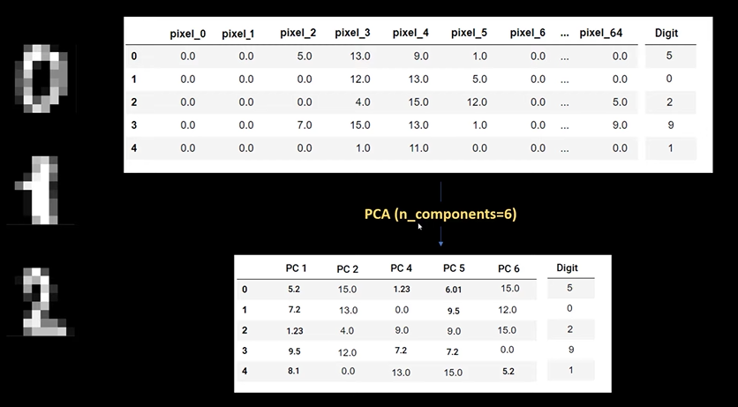

Slide 9
Few things to keep in mind before using PCA
Feature Selection
Scale features before applying PCA
Check for Linearity
Determine the number of components(explained_variance_ratio_)
Accuracy might drop

Slide 10
Advantages
By reducing the data to two dimensions, you can easily visualize it and Prevents Overfitting.
PCA removes multicollinearity. Multicollinearity arises when two features are correlated. PCA produces a set of new orthogonal axes to represent the data, which, as the name suggests, are uncorrelated.
PCA removes noise. By reducing the number of dimensions in the data, PCA can help remove noisy and irrelevant features.
PCA reduces model parameters: PCA can help reduce the number of parameters in machine learning models.
PCA reduces model training time. By reducing the number of dimensions, PCA simplifies the calculations involved in a model, leading to faster training times.

Slide 11
Disadvantages
By reducing the data to two dimensions, you can easily visualize it.
PCA transforms the original input variables into new principal components (or dimensions). The new dimensions offer no interpretability.
While PCA simplifies the data and removes noise, it always leads to some loss of information when we reduce dimensions.
PCA is a linear dimensionality reduction technique, but not all real-world datasets may be linear.
PCA gets affected by outliers. This can distort the principal components and affect the accuracy of the results.

Slide 12
Applications
PCA is used to visualize multidimensional data.
It is used to reduce the number of dimensions in healthcare data.
PCA can help resize an image.
It can be used in finance to analyze stock data and forecast returns.
PCA helps to find patterns in the high-dimensional datasets.

Slide 13
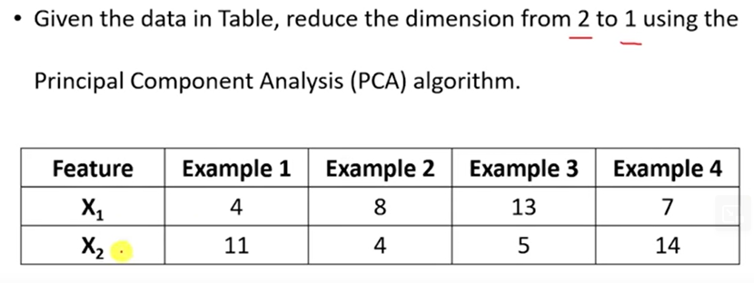
Solved Problem

Slide 14
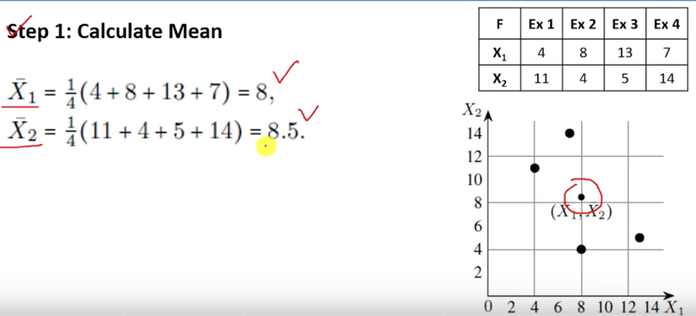
Solved Problem

Slide 15
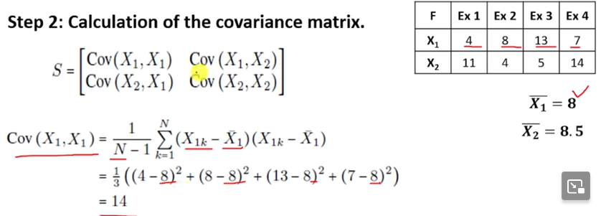
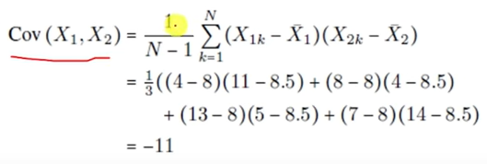
Solved Problem

Slide 16
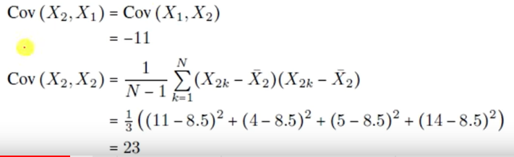
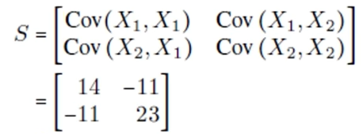
Solved Problem

Slide 17
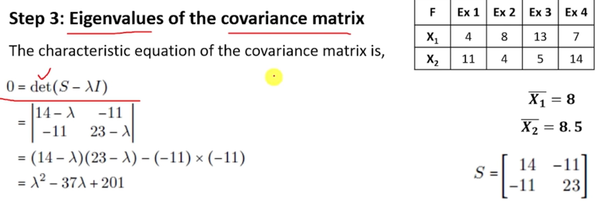
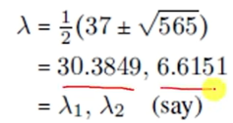

Solved Problem

Slide 18
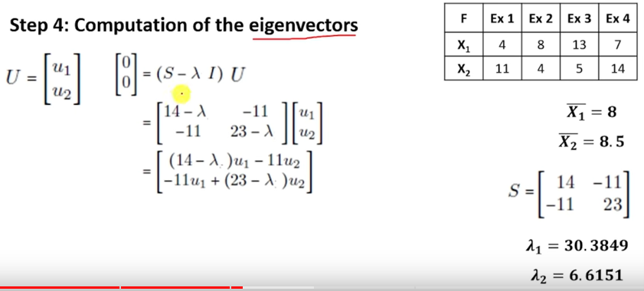
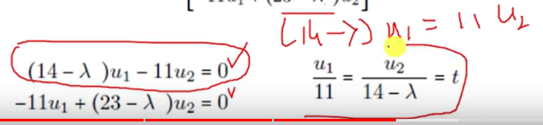
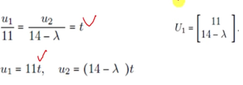
Solved Problem

Slide 19
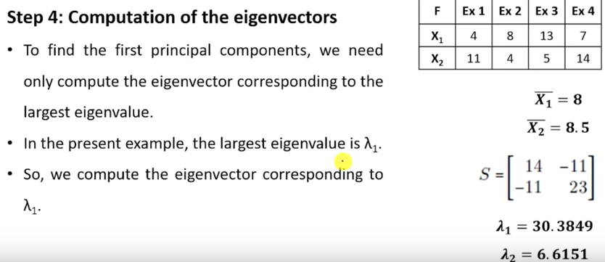
Solved Problem

Slide 20
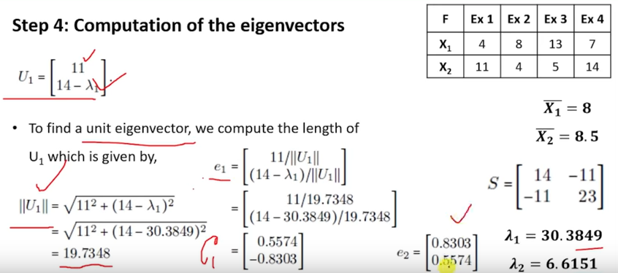
Solved Problem

Slide 21
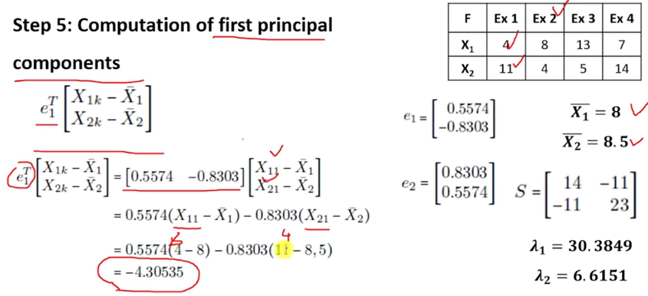
Solved Problem

Slide 22
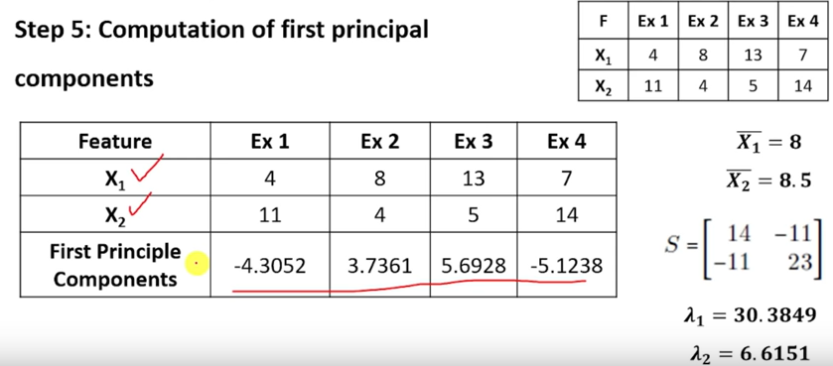
Solved Problem

Slide 23
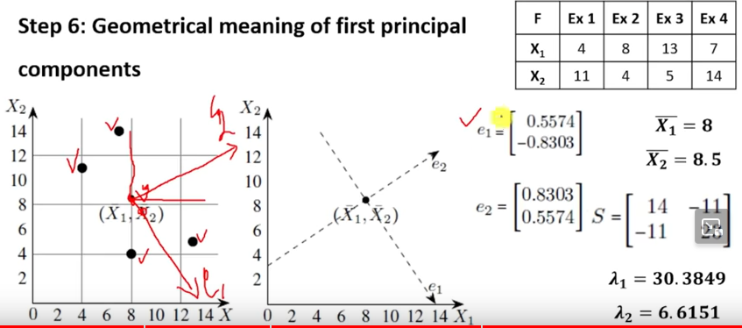
Solved Problem
Mean will becomes origin for eigen vectors

Slide 24
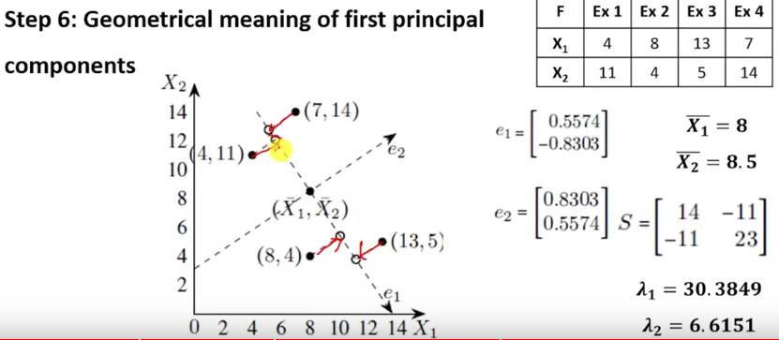
Solved Problem

Slide 25
Reference
https://www.youtube.com/watch?v=8klqIM9UvAc
https://www.youtube.com/watch?v=ZtS6sQUAh0c

